Slide 1
UNO : A WEB APPLICATION USING DJANGO
MUBASHIRA A
REG No:MES20MCA-2029
Product Owner : PROF. KP BALACHANDRAN

Slide 2
TABLE OF CONTENTS
Introduction
Modules
Methodology
RESULTS
Developing Environment
Project plan
User story
Product backlog
Sprint plan
Sprint actual

Slide 3
Introduction
This project revolves around the usage of a web page and its functionalities. Web has been one of the greatest gifts to mankind and we intend to use its fruitful part too.
This project indicates the usage of python, html, Django and bootstrap. It is designed to facilitate multiple domains of knowledge from a single place as it is often seen that information is highly specific and found only at their respective domain holders. With this project we sought to bridge the gap between different kinds of beneficiaries of knowledge. This platform will facilitate all sort of knowledge from all sort of domains like travel, information sciences, tech advancements, politics to name a few.
The availability of platforms like django, bootstrap has not only made the process really timesaving but also hassle free.
Uno is to be spoken as you know? To implicate a wave of curiosity among its users as after all it gives answers to their questions. This web application is supposed to feature a wide domain and global applications. From the world of technology to the vast remains of history and the travelogues all around the world sewed at one place. It will also support multi-lingual features and sections.

Slide 4
MODULES
Admin
Add categories
Approval
rejection
User
User interface
Post questions
View questions
Post answers
Voting
chatting

Slide 5
Methodology
This project is installation of python. We have to be careful in installing python at the correct place as sometimes the system fails to set the path variables by itself. Once python is installed we head to the installation of the backbone “django”.
The installation of django is done through terminal commands from the command prompt. The first step involves changing the directory to where python is installed with “cd” command and then carry forwarding with installation of “pip” which you can do by
Python-m install -upgrade pip

Slide 6
Then we install our virtual environment. The whole idea behind virtual environment is simple that is to create an independent and isolated environment so that other packages and module work unaffected or say independent of anything happening in the virtual environment. In this project install django, install it only in the virtual environment and once we are out of that, python can not recall it.
For virtual environment installation:
Python –m install virtualenv
python –m venv virtualenvironment_name

Slide 7
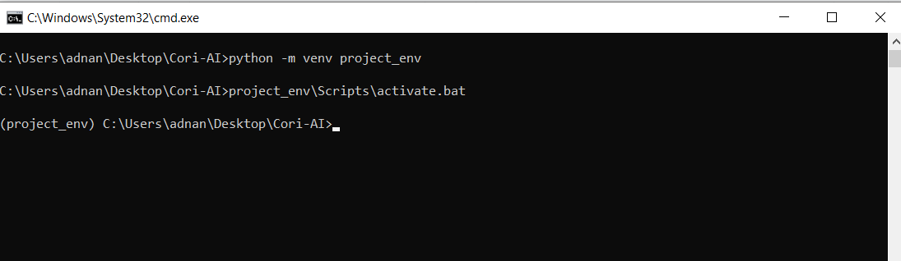
Now change the directory to the virtual environment and head to “scripts” folder and “activate” the virtual environment. Now if do not know about files/folders inside a folder can check them with the “dir” command of cmd. A new folder may also be created with “mkdir folder_name” command
Fig 1 . Interaction with command prompt

Slide 8
After the virtual environment is activated install django by:
python –m pip install django
Now again change the directory and get back one folder with the “ cd ..” command
Here start my project as:
python scripts\django-admin.exe startproject proj_name
Once my project is started change directory to my project and run it on the server to see whether the installation has worked properly or not.
python manage.py runserver

Slide 9
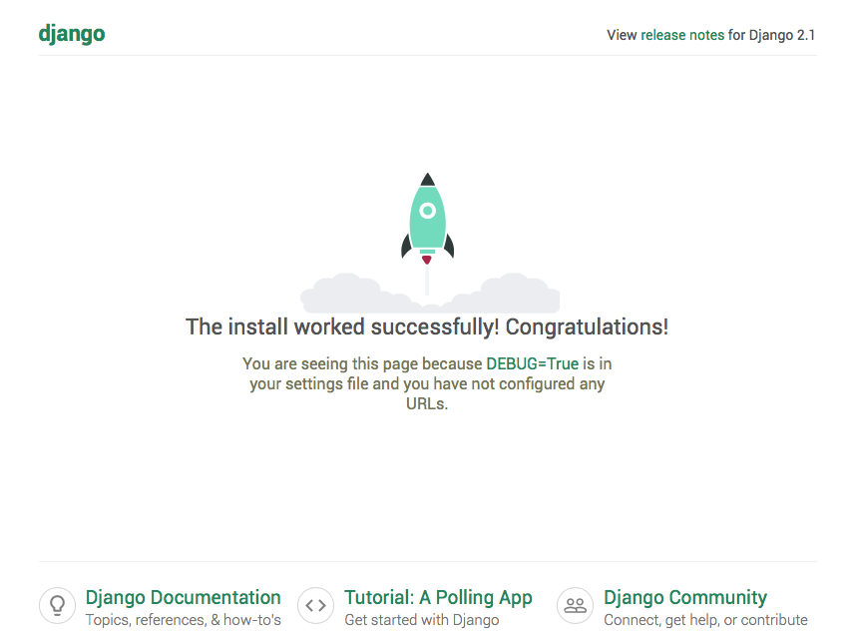
Fig 2. Landing Page of django

Slide 10
Now once the server is initiated go to the address mentioned in the cmd on browser. If you see the above page this means installation was successful.
Now head back to cmd and create an app :
python manage.py startapp blog
For the coding, used VS code has code editor, any other suitable editor may be used to fulfil the purpose such as pycharm which also provides enhanced usability.
When enter the code editor see all my folders created and some other files being automatically created. This is the beauty of django that it reduces the time taken and provides us with predefined set of introductory files that will require for the project.
In the admin section of it first have to register the app in “admin.py” with its name.

Slide 11
2021 3rd international conference on advances in computing, communication control and networking (ICACCCN) 1373 now create an admin for my project by:
Python manage.py create superuser
Once we fill the relevant details see an admin being created for the page.
Now can work on project in the editor but each time i make a change or i add a new class i have to register it in the admin. The idea of the project was to enhance the global chain of information and knowledge by integrating them at a place.

Slide 12
Other than the installation these are the steps follow:
Post questions
View posted questions
Post answers corresponding questions
Add category
Post comments
Voting
Chat
Approval and Rejection
The ER diagram for the same is :

Slide 13
ER Diagram :
admin_id
user_name
user_id
question_id
admi admin n
admin
Category_type
user_email
manages
manages
question
user
phone_no
has a
has a
question_id
Comment_id
answers
comment
Category_type_id
Category_type
has a
answers_id
user_id
category
Category_type

Slide 14
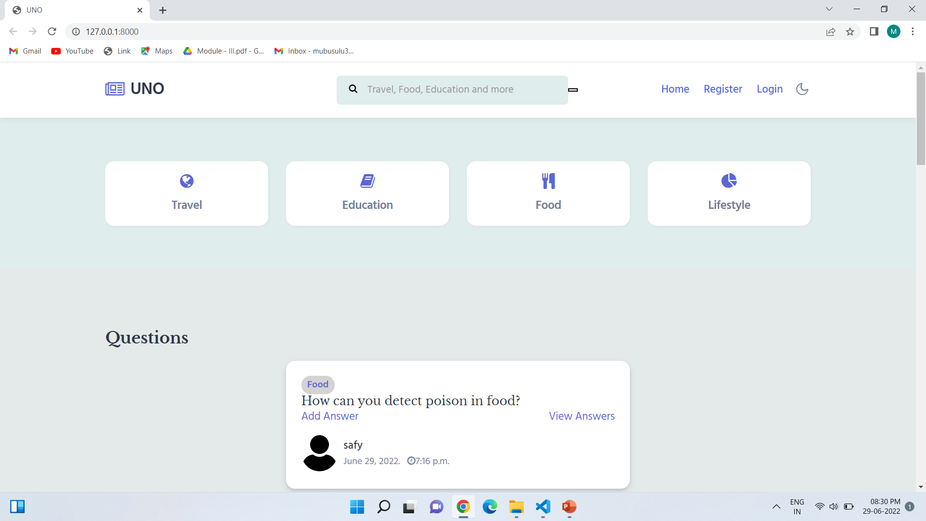
RESULTS

Slide 15
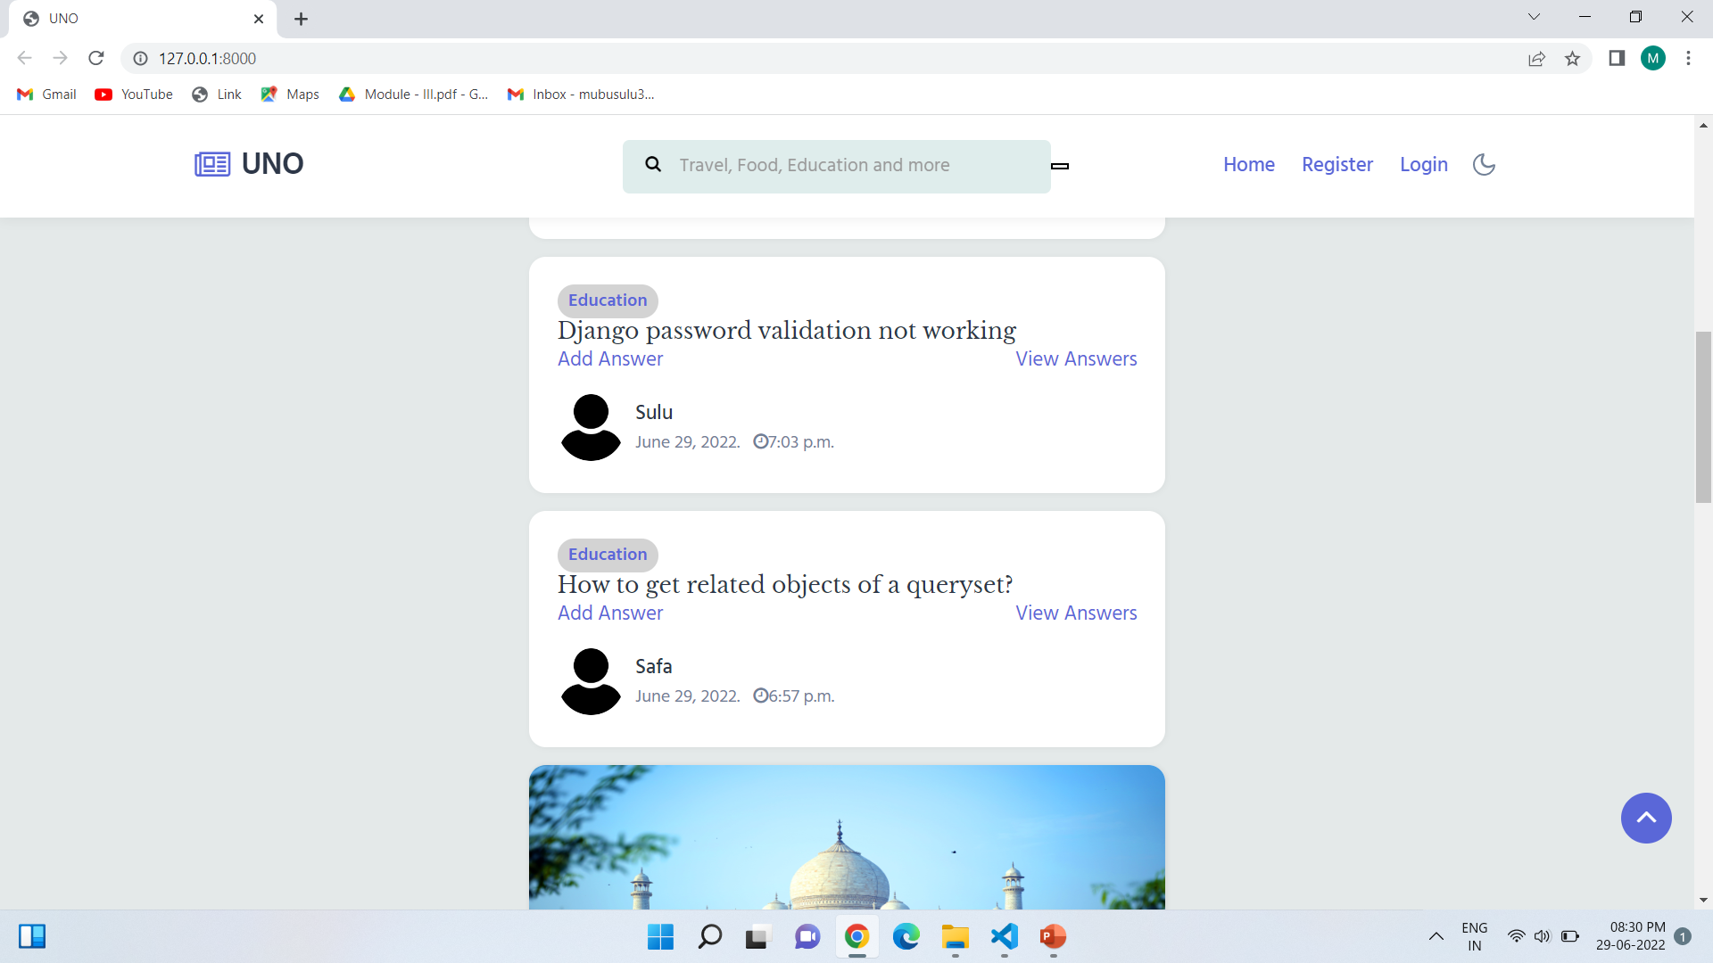

Slide 16
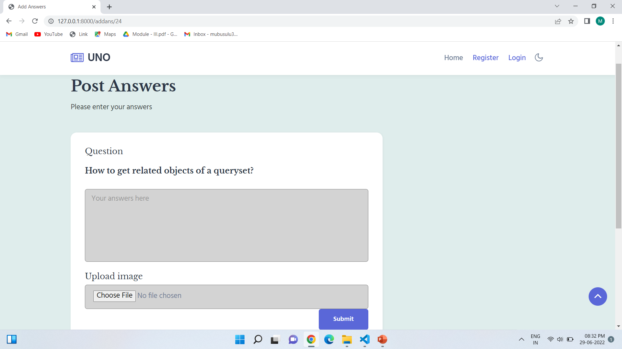

Slide 17
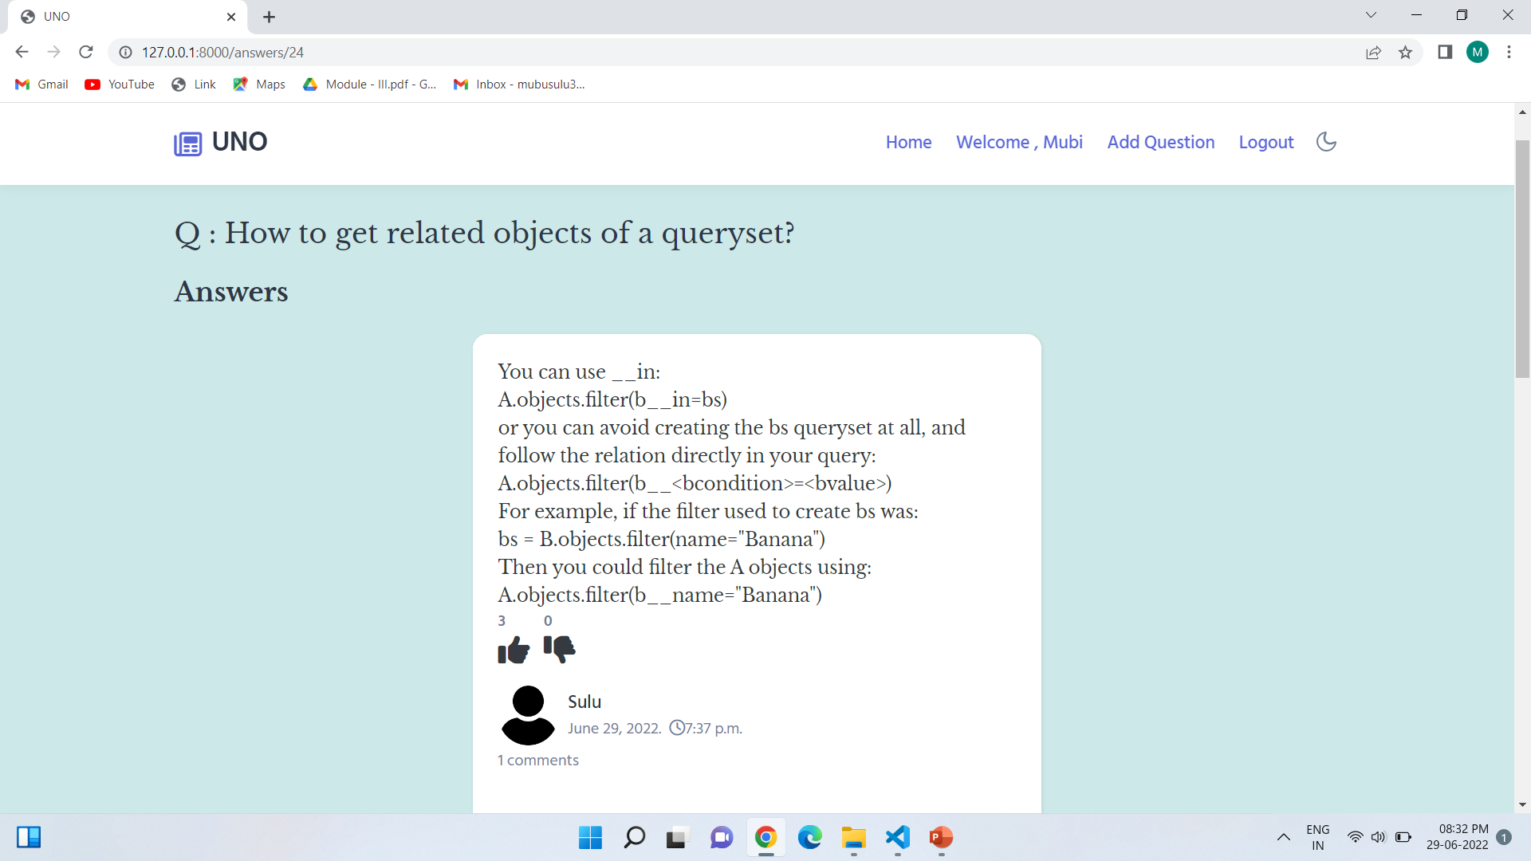

Slide 18
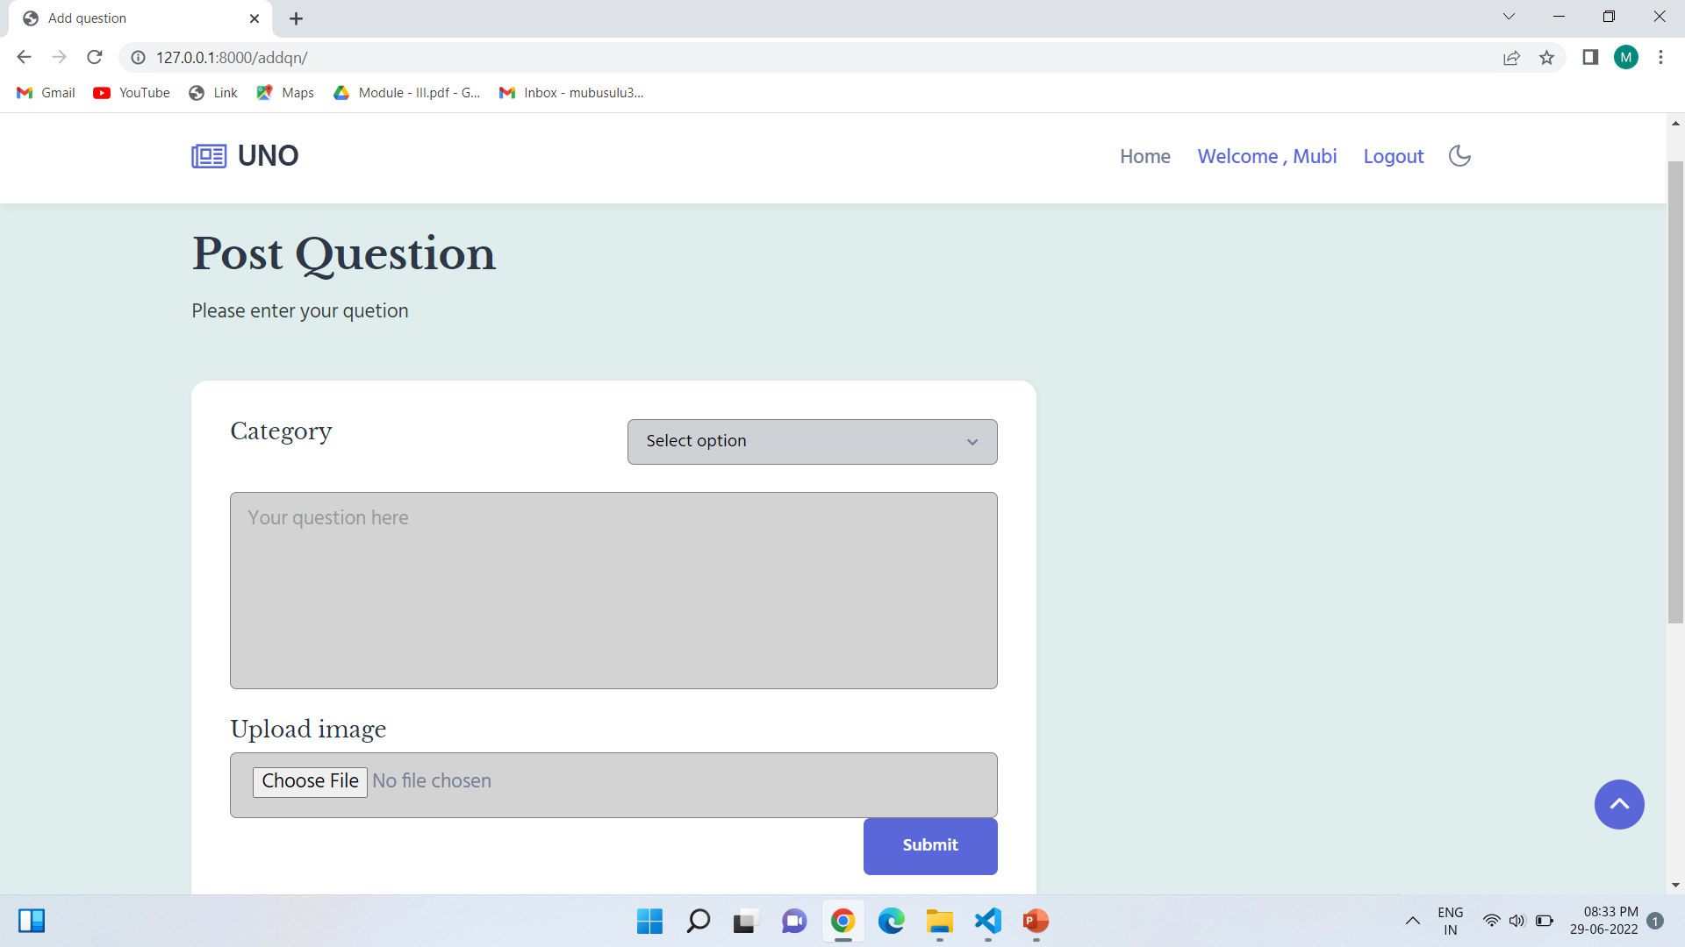

Slide 19
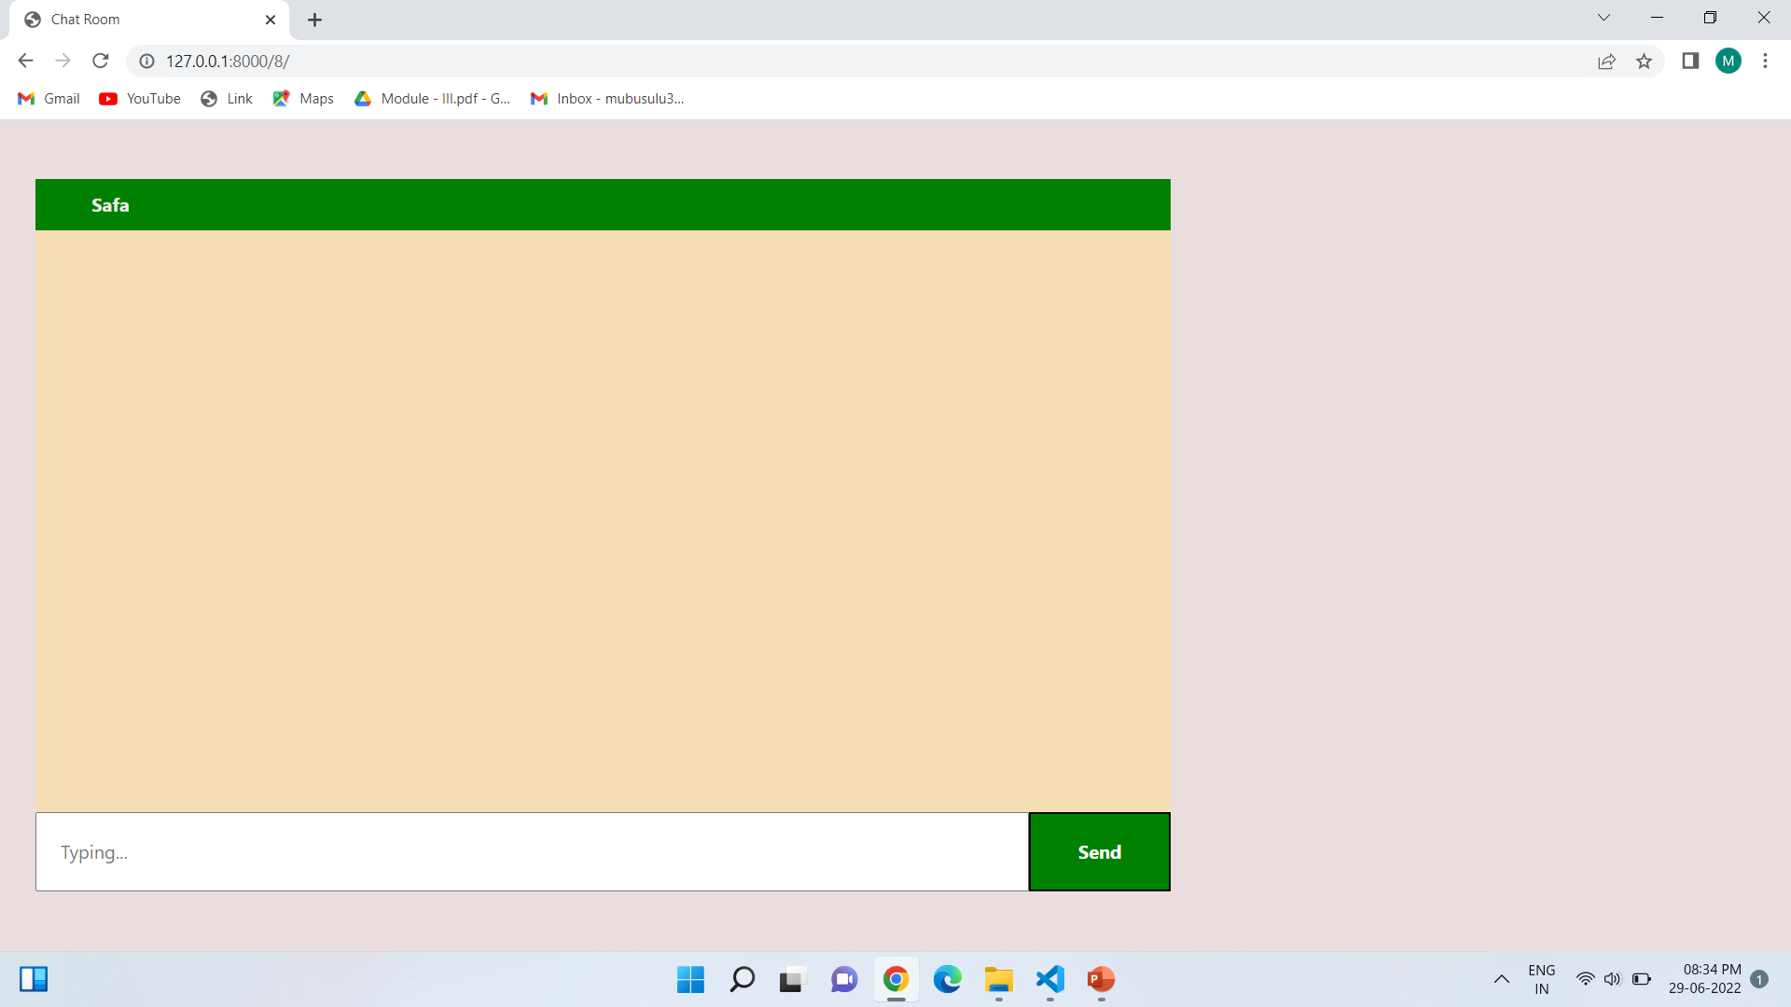

Slide 20
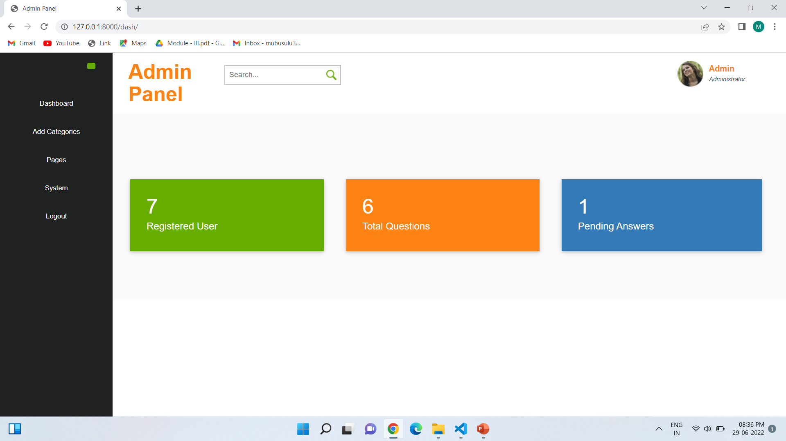

Slide 21
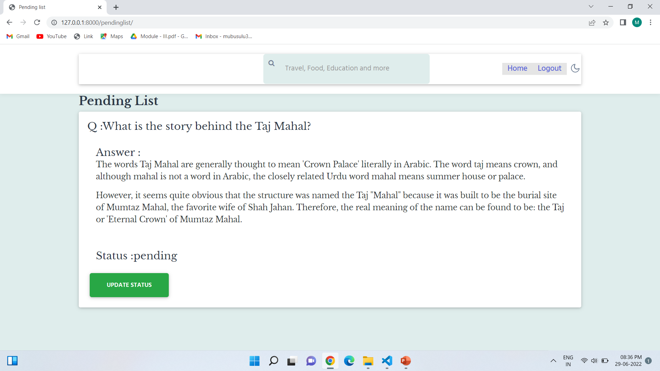

Slide 22
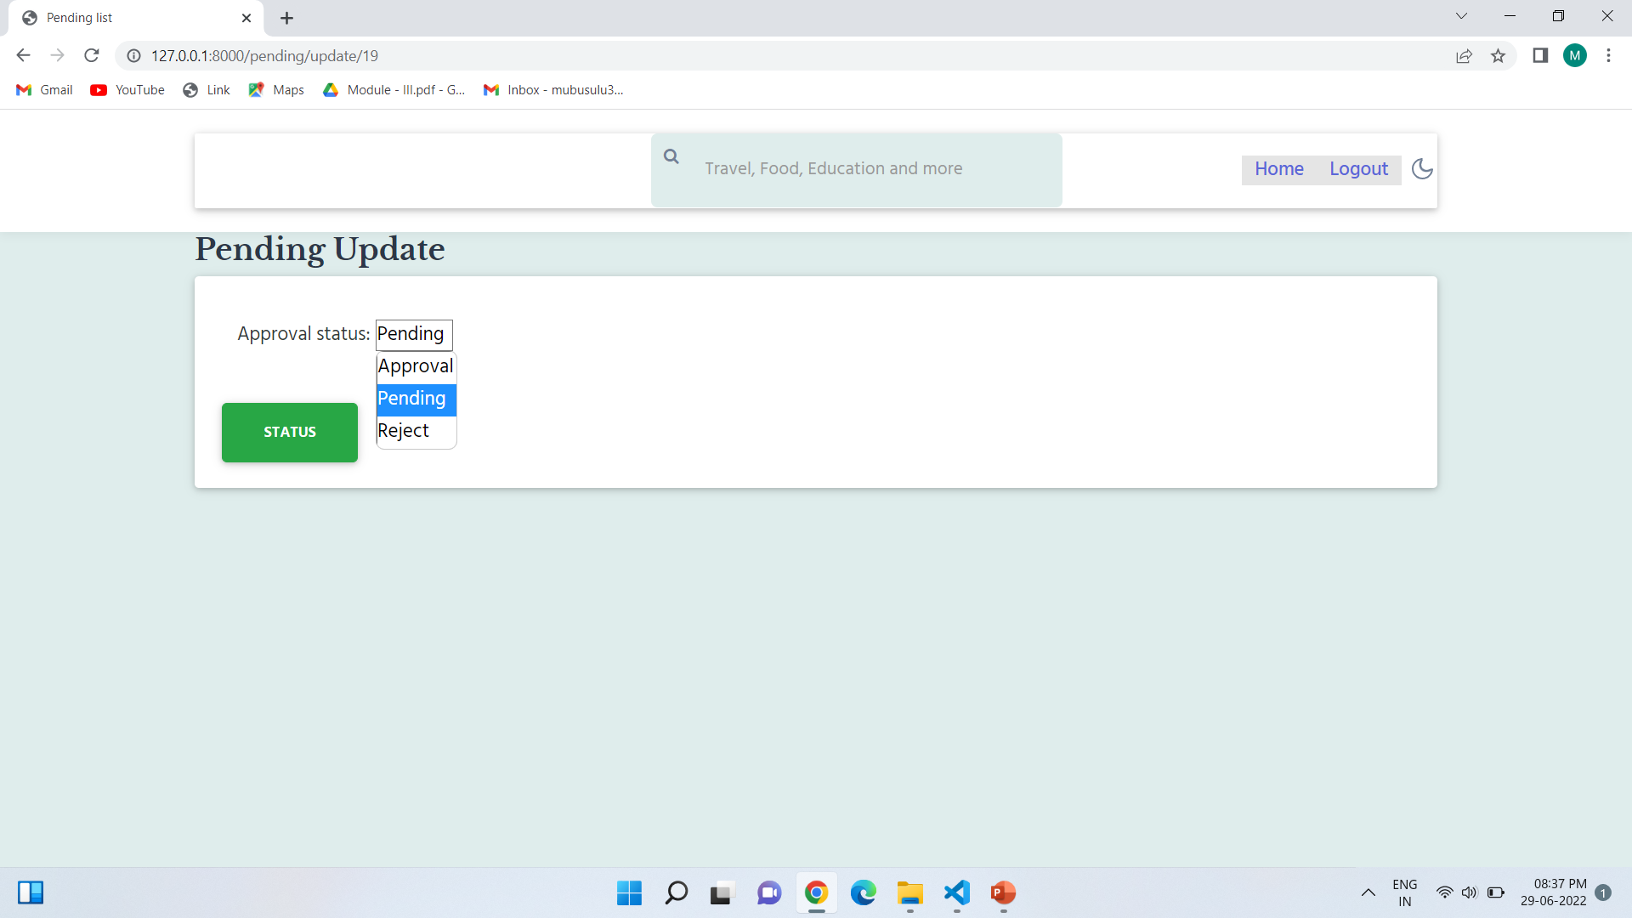

Slide 23
DEVELOPING ENVIRONMENT
HARDWARE SPECIFICATION
• Processor : i3 or above
• Hard Disk : 500 GB
• RAM : 8 GB
SOFTWARE SPECIFICATION
• Language : Python
• Front End : html , bootstrap , JavaScript , CSS
• Back end : SQLite
• framework : Django
• IDE : Visual Studio Code
• OS : Windows

Slide 24
Project plan 27/12/
User Story ID | Task Name | Start Date | End Date | Days | Status
1 | Sprint 1 | 22/04/22 | 28/04/22 | 4 | Completed
2 |  | 29/04/22 | 12/05/22 |  | Completed
3 | Sprint 2 | 13/05/22 | 20/05/22 | 6 | Completed
4 |  | 26/05/22 | 02/06/22 |  | Completed
5 | Sprint 3 | 03/06/22 | 10/06/22 | 6 | Completed
6 |  | 16/06/22 | 23/06/22 |  | Completed
7 | Sprint 4 | 24/06/22 | 25/06/22 | 4 | Completed
8 |  | 28/06/22 | 30/06/22 |  | Completed

Slide 25
User story
User Story ID | As a type of User | I want to <perform some task> | So that I can < Achieve Some Goal>
1 | Admin | Login | I can get access to the system
2 | User | Register | Registering users
3 | User | Login | I can get access to the system
4 | Admin | Add categories | View categories
5 | User | Post questions | View questions
6 | User | Post Answers | View many answers
7 | Admin | Approval/rejection | I can view approved answers
8 | User | Chatting | I can chat to the users

Slide 26
Product backlog
User Story ID | Priority < High /Medium /Low > | Size (Hours) | Sprint <#> | Status < Planned / InProgress / Completed > | Release Date | Release Goal
1 | Medium | 5 | 1 | Completed | 28/04/22 | Registration
2 | High | 5 |  | Completed | 12/05/22 | Login
3 | Medium | 4 | 2 | Completed | 20/05/22 | Add categories
4 | High | 10 |  | Completed | 02/06/22 | Post questions and view questions
5 | High | 8 | 3 | Completed | 10/06/22 | Post answers
6 | High | 5 |  | Completed | 23/06/22 | Approval and rejection
7 | Medium | 5 | 4 | Completed | 25/06/22 | Voting
8 | Medium | 8 |  | Completed | 30/06/22 | Chatting

Slide 27
Sprint Backlog plan
Backlog Item | Status and Completion date | Original Estimate in hours | Day 1 | Day 2 | Day 3 | Day 4 | Day 5 | Day 6 | Day 7 | Day 8 | Day 9 | Day 10 | Day 11 | Day 12 | Day 13 | Day 14
User story #1,2 |  |  | Hours | Hours | Hours | Hours | Hours | Hours | Hours | Hours | Hours | Hours | Hours | Hours | Hours | Hours
UI Designing | 12/05/22 | 10 | 3 | 3 | 4 | 0 | 0 | 0 | 0 | 0 | 0 | 0 | 0 | 0 | 0 | 0
User story #3,4
Add categories | 20/05/22 | 4 | 0 | 0 | 0 | 4 | 0 | 0 | 0 | 0 | 0 | 0 | 0 | 0 | 0 | 0
Post questions | 02/06/22 | 10 | 0 | 0 | 0 | 0 | 4 | 3 | 3 | 0 | 0 | 0 | 0 | 0 | 0 | 0
User story #5,6
Post answers | 23/06/22 | 13 | 0 | 0 | 0 | 0 | 0 | 0 | 0 | 3 | 3 | 4 | 3 | 0 | 0 | 0
User story #7,8
Voting | 25/06/22 | 5 | 0 | 0 | 0 | 0 | 0 | 0 | 0 | 0 | 0 | 0 | 0 | 4 | 1 | 0
Chatting | 30/06/22 | 8 | 2 | 0 | 0 | 0 | 0 | 0 | 0 | 0 | 0 | 0 | 0 | 0 | 3 | 3
Total |  | 50 | 5 | 3 | 4 | 4 | 4 | 3 | 3 | 3 | 3 | 4 | 3 | 4 | 4 | 3

Slide 28
Sprint 1 Backlog Actuals
Backlog Item | Status and Completion date | Original Estimate in hours | Day 1 | Day 2 | Day 3 | Day 4 | Day 5 | Day 6 | Day 7 | Day 8 | Day 9 | Day 10 | Day 11 | Day 12 | Day 13 | Completed <Y/N>
User story #1,2 |  |  | Hours | Hours | Hours | Hours | Hours | Hours | Hours | Hours | Hours | Hours | Hours | Hours | Hours
UI Designing | 12/05/22 | 10 | 3 | 3 | 4 | 0 | 0 | 0 | 0 | 0 | 0 | 0 | 0 | 0 | 0 | Y
User story #3,4
Add categories | 20/05/22 | 4 | 0 | 0 | 0 | 4 | 0 | 0 | 0 | 0 | 0 | 0 | 0 | 0 | 0 | N
Post questions | 02/06/22 | 10 | 0 | 0 | 0 | 0 | 4 | 3 | 3 | 0 | 0 | 0 | 0 | 0 | 0 | N
User story #5,6
Post answers | 23/06/22 | 13 | 0 | 0 | 0 | 0 | 0 | 0 | 0 | 3 | 3 | 4 | 3 | 0 | 0 | N
User story #7,8
Voting | 25/06/22 | 5 | 0 | 0 | 0 | 0 | 0 | 0 | 0 | 0 | 0 | 0 | 0 | 4 | 1 | N
Chatting | 30/06/22 | 8 | 2 | 3 | 0 | 0 | 0 | 0 | 0 | 0 | 0 | 0 | 0 | 0 | 3 | N
Total |  | 50 | 5 | 6 | 4 | 4 | 4 | 3 | 3 | 3 | 3 | 4 | 3 | 4 | 4

Slide 29
Sprint 2 Backlog Actuals
Backlog Item | Status and Completion date | Original Estimate in hours | Day 1 | Day 2 | Day 3 | Day 4 | Day 5 | Day 6 | Day 7 | Day 8 | Day 9 | Day 10 | Day 11 | Day 12 | Day 13 | Completed <Y/N>
User story #1,2 |  |  | Hours | Hours | Hours | Hours | Hours | Hours | Hours | Hours | Hours | Hours | Hours | Hours | Hours
UI Designing | 12/05/22 | 10 | 3 | 3 | 4 | 0 | 0 | 0 | 0 | 0 | 0 | 0 | 0 | 0 | 0 | Y
User story #3,4
Add categories | 20/05/22 | 4 | 0 | 0 | 0 | 4 | 0 | 0 | 0 | 0 | 0 | 0 | 0 | 0 | 0 | Y
Post questions | 02/06/22 | 10 | 0 | 0 | 0 | 0 | 4 | 3 | 3 | 0 | 0 | 0 | 0 | 0 | 0 | Y
User story #5,6
Post answers | 23/06/22 | 13 | 0 | 0 | 0 | 0 | 0 | 0 | 0 | 3 | 3 | 4 | 3 | 0 | 0 | N
User story #7,8
Voting | 25/06/22 | 5 | 0 | 0 | 0 | 0 | 0 | 0 | 0 | 0 | 0 | 0 | 0 | 4 | 1 | N
Chatting | 30/06/22 | 8 | 2 | 3 | 0 | 0 | 0 | 0 | 0 | 0 | 0 | 0 | 0 | 0 | 3 | N
Total |  | 50 | 5 | 6 | 4 | 4 | 4 | 3 | 3 | 3 | 3 | 4 | 3 | 4 | 4

Slide 30
Sprint 3 Backlog Actuals
Backlog Item | Status and Completion date | Original Estimate in hours | Day 1 | Day 2 | Day 3 | Day 4 | Day 5 | Day 6 | Day 7 | Day 8 | Day 9 | Day 10 | Day 11 | Day 12 | Day 13 | Completed <Y/N>
User story #1,2 |  |  | Hours | Hours | Hours | Hours | Hours | Hours | Hours | Hours | Hours | Hours | Hours | Hours | Hours
UI Designing | 12/05/22 | 10 | 3 | 3 | 4 | 0 | 0 | 0 | 0 | 0 | 0 | 0 | 0 | 0 | 0 | Y
User story #3,4
Add categories | 20/05/22 | 4 | 0 | 0 | 0 | 4 | 0 | 0 | 0 | 0 | 0 | 0 | 0 | 0 | 0 | Y
Post questions | 02/06/22 | 10 | 0 | 0 | 0 | 0 | 4 | 3 | 3 | 0 | 0 | 0 | 0 | 0 | 0 | Y
User story #5,6
Post answers | 23/06/22 | 13 | 0 | 0 | 0 | 0 | 0 | 0 | 0 | 3 | 3 | 4 | 3 | 0 | 0 | Y
User story #7,8
Voting | 25/06/22 | 5 | 0 | 0 | 0 | 0 | 0 | 0 | 0 | 0 | 0 | 0 | 0 | 4 | 1 | N
Chatting | 30/06/22 | 8 | 2 | 3 | 0 | 0 | 0 | 0 | 0 | 0 | 0 | 0 | 0 | 0 | 3 | N
Total |  | 50 | 5 | 6 | 4 | 4 | 4 | 3 | 3 | 3 | 3 | 4 | 3 | 4 | 4

Slide 31
Sprint 4 Backlog Actuals
Backlog Item | Status and Completion date | Original Estimate in hours | Day 1 | Day 2 | Day 3 | Day 4 | Day 5 | Day 6 | Day 7 | Day 8 | Day 9 | Day 10 | Day 11 | Day 12 | Day 13 | Completed <Y/N>
User story #1,2 |  |  | Hours | Hours | Hours | Hours | Hours | Hours | Hours | Hours | Hours | Hours | Hours | Hours | Hours
UI Designing | 12/05/22 | 10 | 3 | 3 | 4 | 0 | 0 | 0 | 0 | 0 | 0 | 0 | 0 | 0 | 0 | Y
User story #3,4
Add categories | 20/05/22 | 4 | 0 | 0 | 0 | 4 | 0 | 0 | 0 | 0 | 0 | 0 | 0 | 0 | 0 | Y
Post questions | 02/06/22 | 10 | 0 | 0 | 0 | 0 | 4 | 3 | 3 | 0 | 0 | 0 | 0 | 0 | 0 | Y
User story #5,6
Post answers | 23/06/22 | 13 | 0 | 0 | 0 | 0 | 0 | 0 | 0 | 3 | 3 | 4 | 3 | 0 | 0 | Y
User story #7,8
Voting | 25/06/22 | 5 | 0 | 0 | 0 | 0 | 0 | 0 | 0 | 0 | 0 | 0 | 0 | 4 | 1 | Y
Chatting | 30/06/22 | 8 | 2 | 3 | 0 | 0 | 0 | 0 | 0 | 0 | 0 | 0 | 0 | 0 | 3 | Y
Total |  | 50 | 5 | 6 | 4 | 4 | 4 | 3 | 3 | 3 | 3 | 4 | 3 | 4 | 4

Slide 32
THANK YOU

